Slide 1
Case study of Yelp

Slide 2
Yelp Reviews
Yelp reviews and ratings are important source of information to make informed decisions about a venue. We conjecture that further classification of yelp reviews into relevant categories can help users to make an informed decision based on their personal preferences for categories, in our case for Italian and pizza. Moreover, this aspect is especially useful when users do not have time to read many reviews to infer the popularity of venues

Slide 3
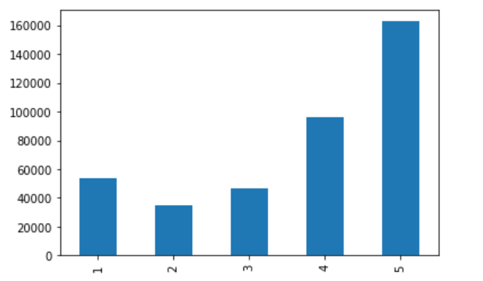
Reviews for Restaurants which serves Italian or Pizza
No. of Reviews
Stars

Slide 4
Reviews
No. of Good reviews: 162623
No. of Bad reviews: 135275
*Reviews are considered good if they have 5 stars and bad if they are 3 and below.

Slide 5
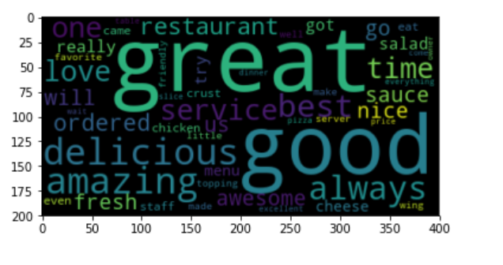
Good Reviews where key words are highlighted

